Slide 1
Productivity Prediction of Garment Employees
Kazi Hasan Ibn Arif
Nafiur Rahman Khadem

Slide 2
Motivation
The Garment Industry: one of the key examples of the industrial globalization of this modern era
Highly labor-intensive industry with lots of manual processes
It’s highly desirable among the decision makers in the garments industry to track, analyze and predict the productivity performance of the working teams in their factories.

Slide 3
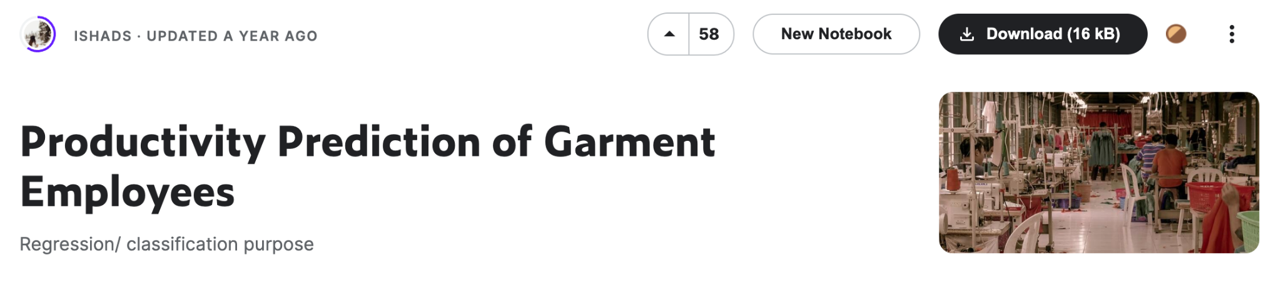
Data part
# Column Non-Null Count Dtype
--- ------ -------------- -----
0 date 1197 non-null object
1 quarter 1197 non-null object
2 department 1197 non-null object
3 day 1197 non-null object
4 team 1197 non-null int64
5 targeted_productivity 1197 non-null float64
6 smv 1197 non-null float64
7 wip 691 non-null float64
8 over_time 1197 non-null int64
9 incentive 1197 non-null int64
10 idle_time 1197 non-null float64
11 idle_men 1197 non-null int64
12 no_of_style_change 1197 non-null int64
13 no_of_workers 1197 non-null float64
14 actual_productivity 1197 non-null float64

Slide 4
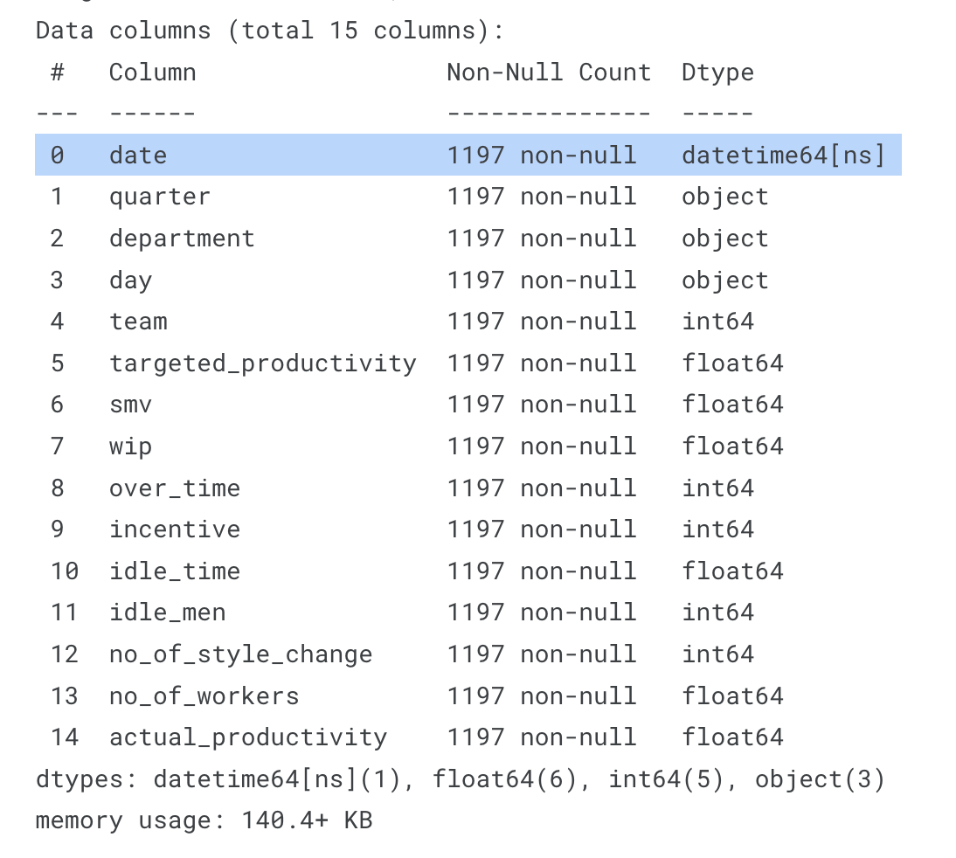
Is there any missing values and what are the data types of each feature?
Process: We counted non-null value and type of each column.
Conclusion: Only ‘wip’ column has missing values, almost half of the values are missing. Also, the dataset has both numerical and categorical features.

Slide 5
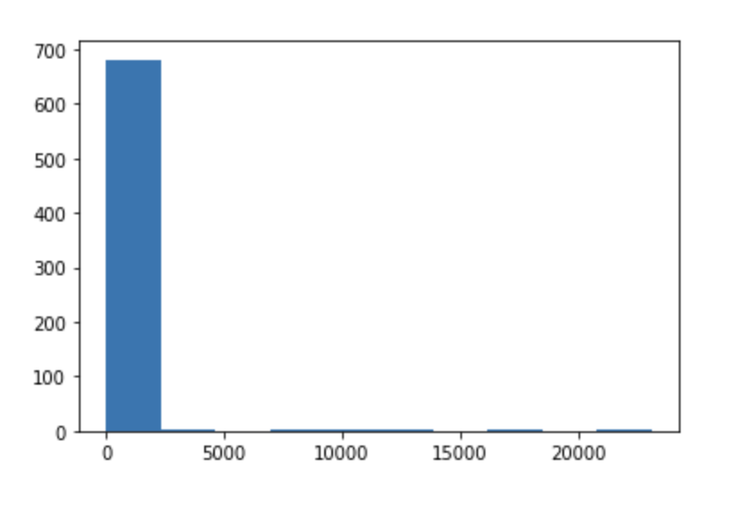
As ‘wip’ has missing values, how to resolve this?
Process: Plotting the distribution of ‘wip’ will give us an idea about how to fill those missing fields.
Conclusion: Almost all of the values are 0, so we can fill the rows with the mode 0.

Slide 6
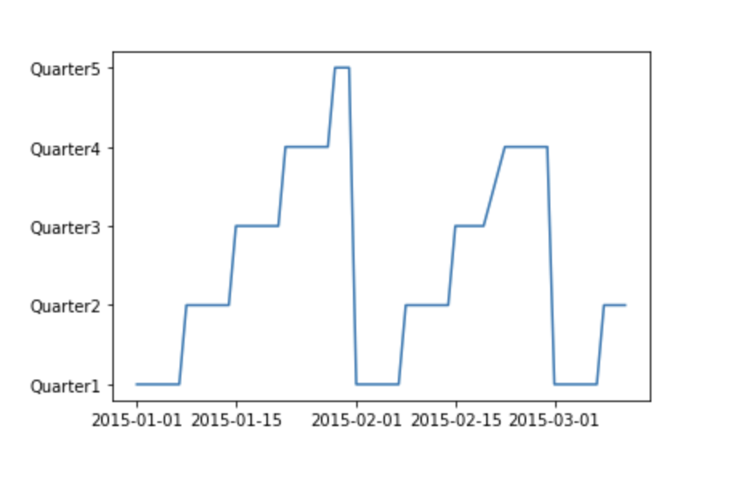
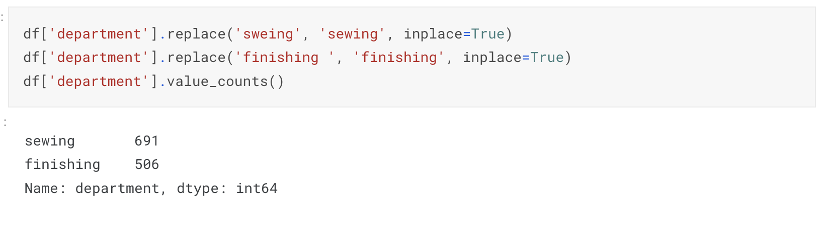
How to use the date object as a feature?
Process: First we need to plot the ‘date’ column to understand the distribution.
Conclusion: Plotting date and found that all the data are from same year and there are only 3 different months, so we only extract the day of month as a numeric feature.

Slide 7
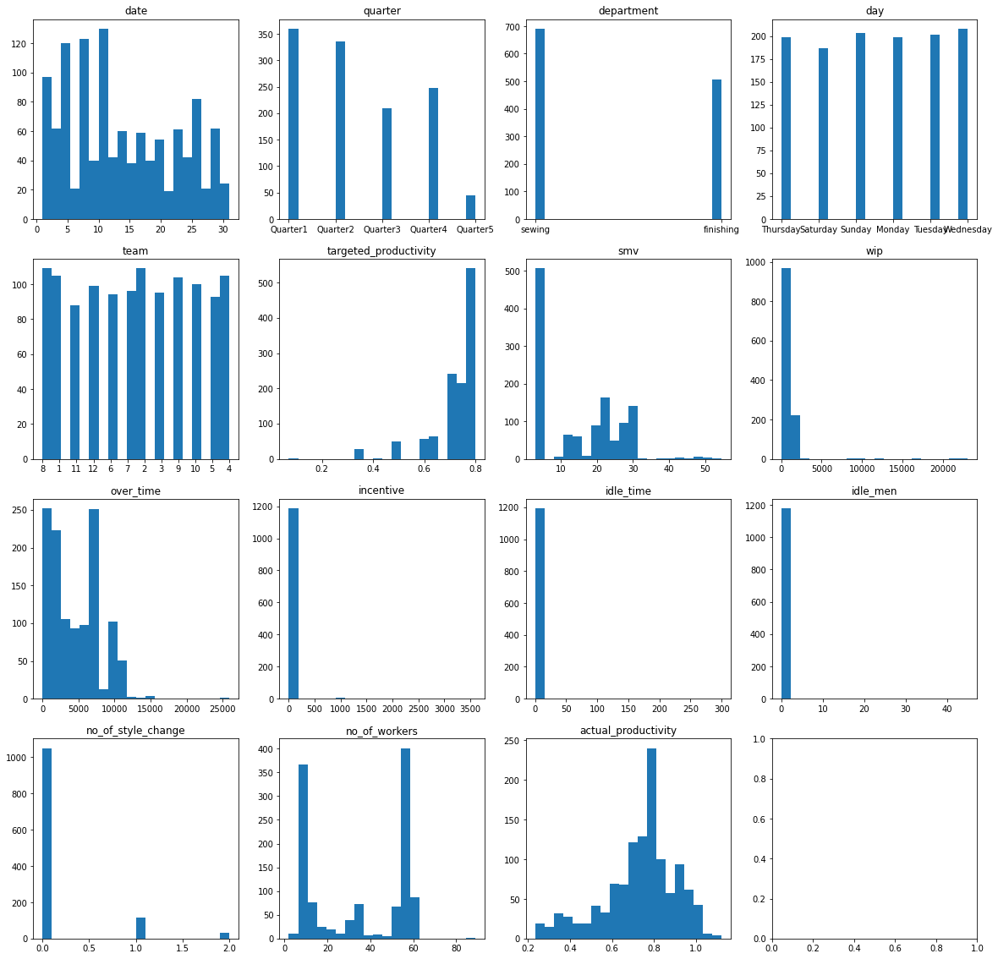
Is there any column that needs to be dropped?
Process: We plotted the data distributions for all the columns.
Conclusion: From the distribution above idle_men and idle_time features seem to be useless for predicting actual_productivity, almost all of their values are zero and the rest few do not seem to produce any pattern with the other features. So we discard them. We also drop the date for now as it also shows no importance.

Slide 8
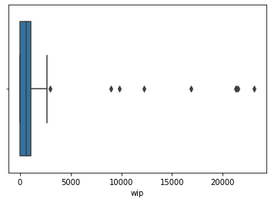
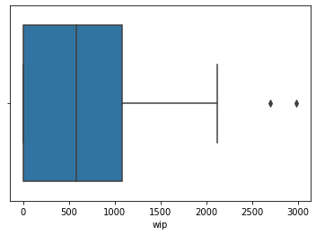
The ‘wip’ column may contain some outliers, how to resolve it?
Process: First we need to plot the boxplot of ‘wip’
Conclusion: The boxplot of wip indicates that they have huge outliers. We will drop those rows.
df = df[df['wip']<=5000]

Slide 9
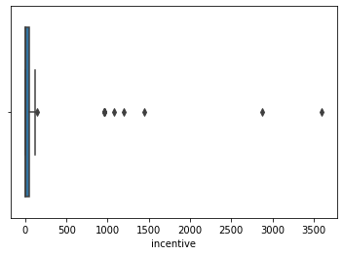

The ‘incentive’ column may contain outliers too.
Process: Likewise ‘wip’, we will observe the boxplot to understand if there are any outliers.
Conclusion: It contains outlier. And the number of outliers is fairly small, so we can discard them.
df = df[df['incentive']<=500]

Slide 10
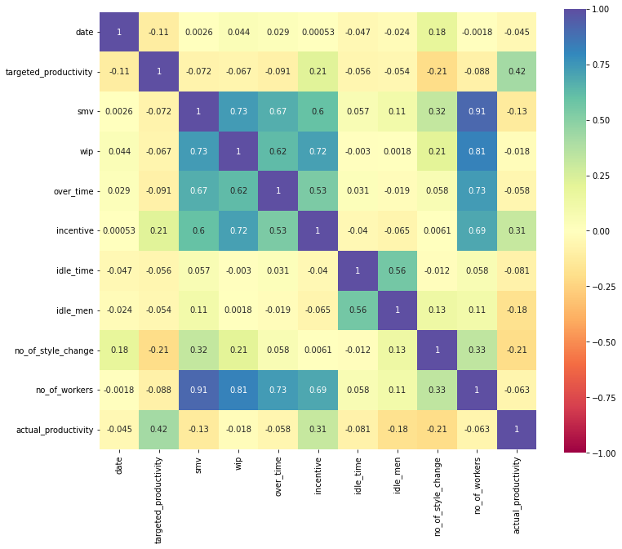
Are all the features correlated to the target?
idle_men and idle_time features seem to be useless for predicting actual_productivity, almost all of their values are zero and the rest few doesn't seem to produce any pattern with the other features. So we discard them. We also drop date for now as it also shows no importance.

Slide 11
Data Preparation
Null value fix: There was a significant amount of null values in ‘wip’ which we couldn’t possibly discard, but the overwhelming majority of ‘wip’ was 0 so we replaced all null values with 0.
Data type fix: ‘date’ was in object format, so we converted it to datetime. We also noticed that there were only 3 months’ data of the same year so we only kept the day of month.
Typo fix: In the ‘department’ column, ‘sweing’ was used instead of ‘sewing’, some rows contained an extra space at the end (‘finishing ‘ instead of ‘finishing’). We fixed them.
Outlier removal: The boxplots of ‘wip’ and ‘incentive’ showed that they have huge but
very few outliers, so we discarded them.

Slide 12
Data Preparation
Feature selection: Most values of idle_men, idle_time were zero. These columns along with date showed almost no correlation with our target variable, so we removed them.
One hot encoding: We used one hot encoding for the categorical features 'quarter', 'department', 'day', 'team'.
Normalization: We scaled the numeric features using the standard scaler which transformed mean to 0 and variance to 1.

Slide 13
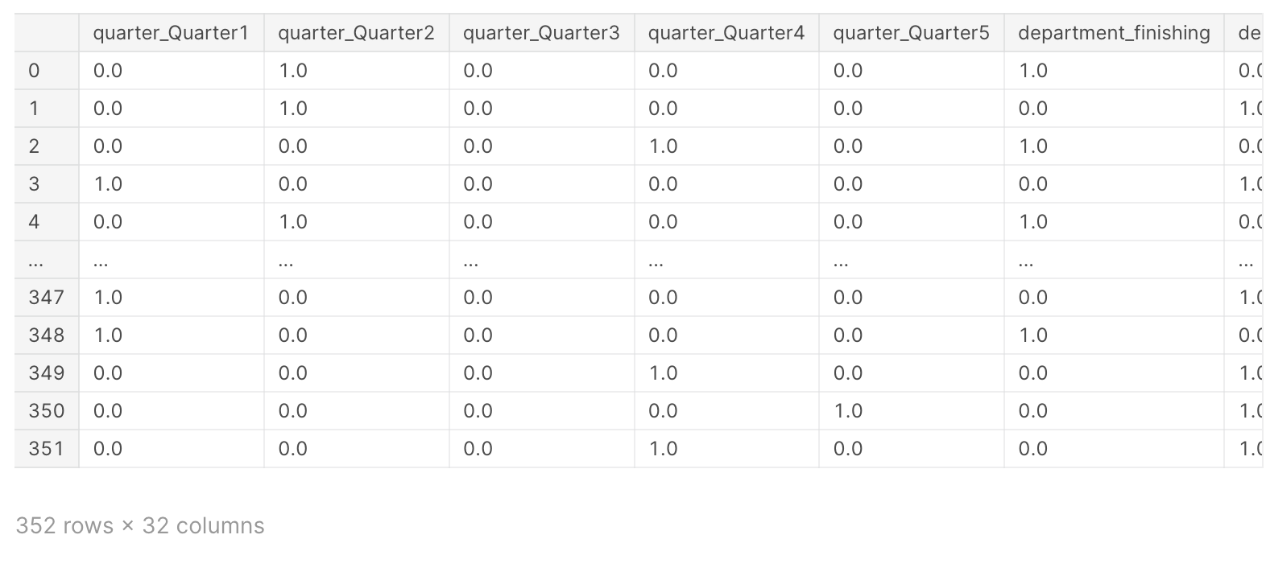
One-hot encoding and Normalization
One-hot encoding for Categorical features
Quarter
Department
Day
Team
StandardScaler for numeric features (makes mean=0 and variance=1 for training data)

Slide 14
Our target is to classify whether actual productivity reached the target productivity or not
Dataset is imbalanced.
False : 479
True : 700
Class distribution should be taken care of while splitting
Weighted F1 score as performance metrics

Slide 15
Dataset split
Train : 60%
Validation : 20%
Test : 20%

Slide 16
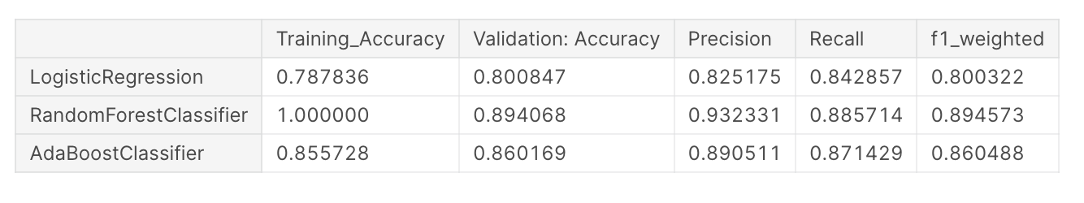
Model evaluation
Base model selection
And Training

Slide 17
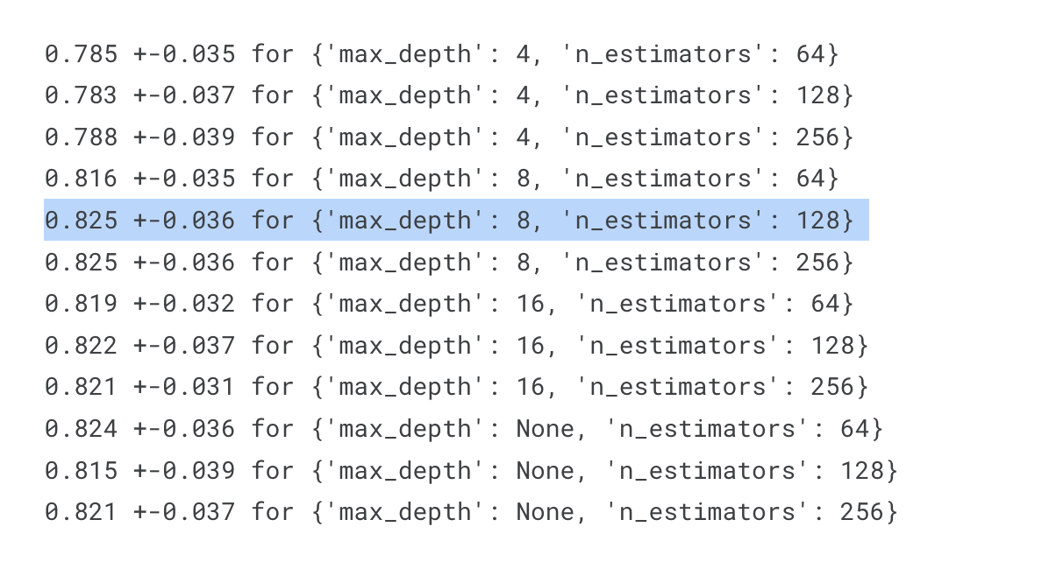
Hyperparameter tuning
Grid search cross validation
Best parameters:
'max_depth': 8
'n_estimators': 128

Slide 18
Pruning
We tuned the values of minimum impurity increase and alpha for cost complexity pruning.
Neither of them improved the results.

Slide 19
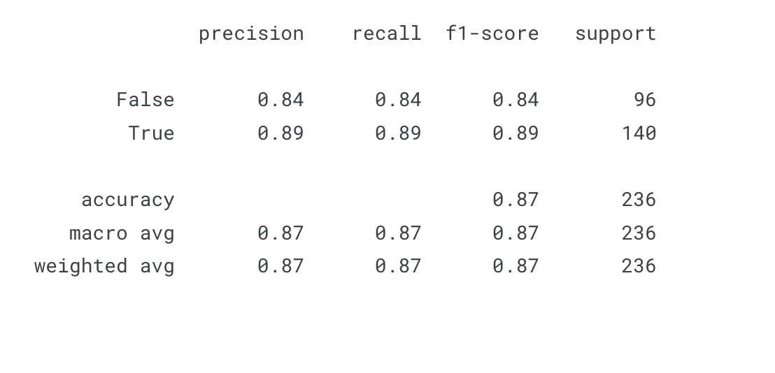
Test results of the best model

Slide 20
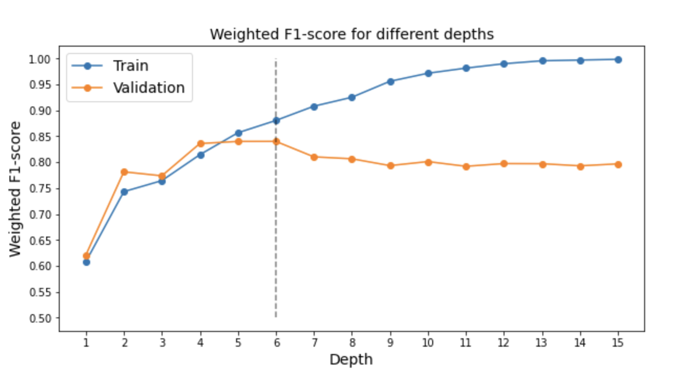
Error analysis
Type 1 errors (false positives) and Type 2 errors (false negatives)

Slide 21
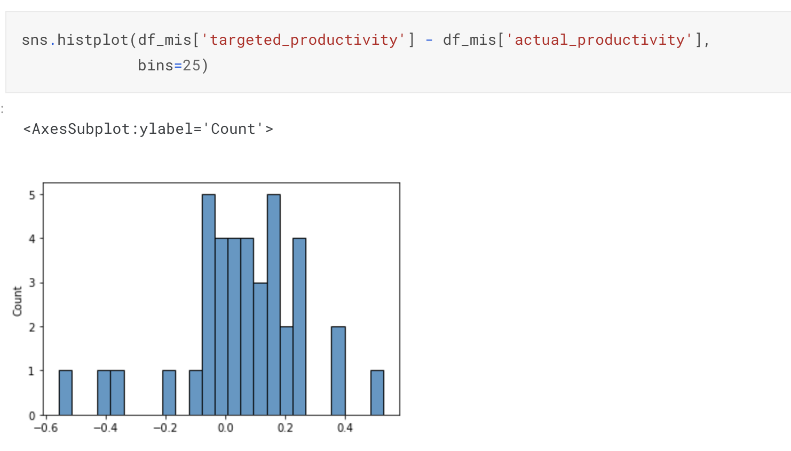
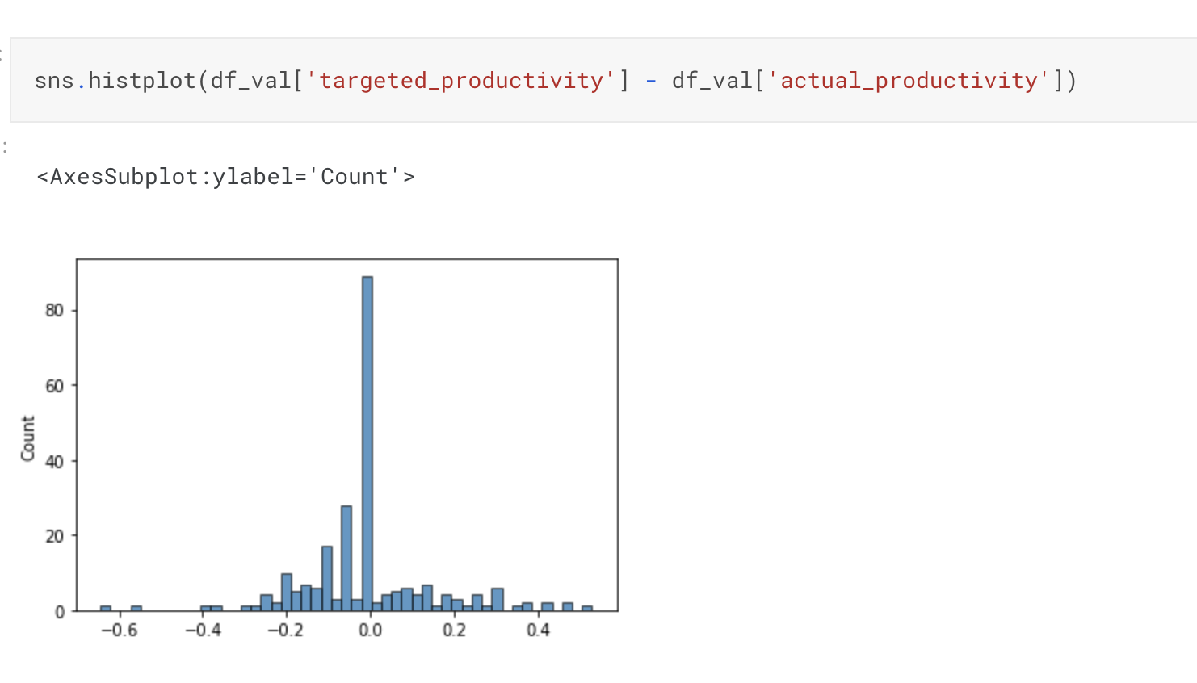
Error analysis
It seems that the model performs quite poorly when target is missed by comparatively huge margin. Maybe these cases are caused by other factors like fatigue.

Slide 22
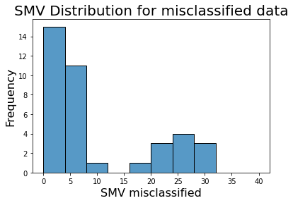
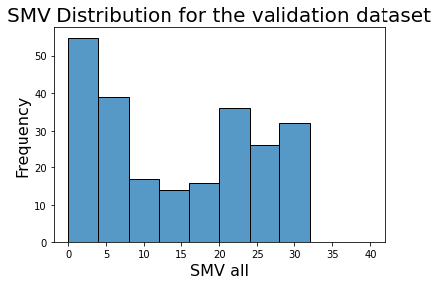
Error analysis
Maybe anomalous productivity is related with extreme (too small or too large) deadlines.

Slide 23
Next Step
Trying randomization for splitting point (Extra Trees)

Slide 24
Github Link
https://github.com/GitFazz/Fuse-Project-1

Slide 25

Thanks!

